Slide 1
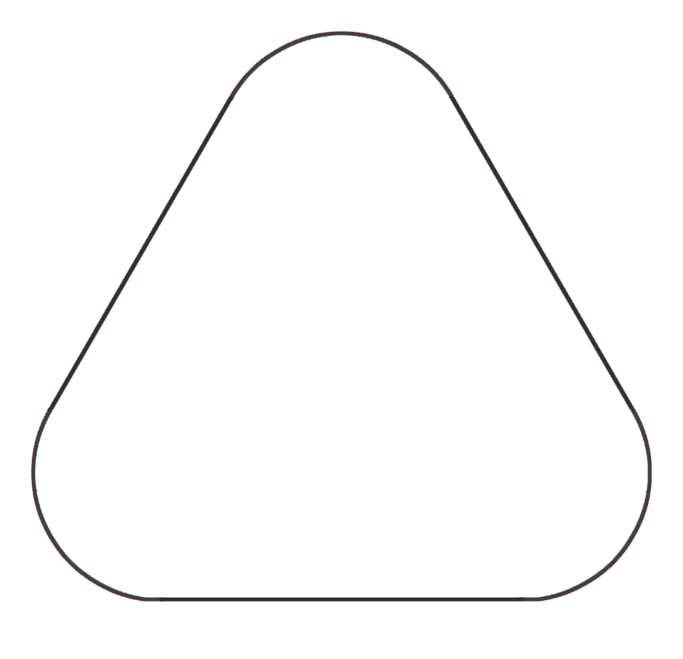


Slide 4
GDP1 Mission Patch V1

